Slide 1
Core Methods in Educational Data Mining
EDUC6191 Fall 2022

Slide 2
Continuing from last class

Slide 3
Knowledge Engineering
What is knowledge engineering?

Slide 4
Knowledge Engineering
What is the difference between good knowledge engineering and bad knowledge engineering?

Slide 5
Knowledge Engineering
What is the difference between (good) knowledge engineering and EDM?
What are the advantages and disadvantages of each?

Slide 6
Comments? Questions?

Slide 7
Automated Feature Generation
What are the advantages of automated feature generation, as compared to feature engineering?
What are the disadvantages?

Slide 8
FCBF: What Variables will be kept? (Cutoff = 0.65 for predictor-predictor)
What variables emerge from this table?
 | G | H | I | J | K | L | Predicted
G |  | .7 | .8 | .8 | .4 | .3 | .72
H |  |  | .8 | .7 | .6 | .5 | .38
I |  |  |  | .8 | .3 | .4 | .82
J |  |  |  |  | .8 | .1 | .75
K |  |  |  |  |  | .5 | .64
L |  |  |  |  |  |  | .42

Slide 9
Questions about FCBF?

Slide 10
Other questions

Slide 11
CA2
The second creative assignment… done…
The semester is flying by

Slide 12
What was your process for feature engineering for CA2?
How did you decide what features to create?

Slide 13
Did feature engineering make your model better?

Slide 14
What tools did you use to create features?

Slide 15
Any other comments about your process/results in CA2?

Slide 16
Network Analysis

Slide 17
Four types of centrality
What were they again?

Slide 18
Four types of centrality
Degree centrality
Closeness centrality
Betweeness centrality
Eigenvector centrality

Slide 19
What does each one mean conceptually?
Degree centrality
Closeness centrality
Betweeness centrality
Eigenvector centrality

Slide 20
In the text, I described several types of nodes
In a graph of classroom interactions, there could be several different types of nodes
Teacher
TA
Student
Project Leader
Project Scribe

Slide 21
In the text, I described several types of links
In a graph of classroom interactions, there could be several types of links
Leadership role (X leads Y)
Working on same learning resource
Helping act
Criticism act
Insult
Note that links can be directed or undirected

Slide 22
Questions or comments?

Slide 23
Network Analysis
The most common use of network analysis is for social networks
Where else might it apply?

Slide 24
Let’s list examples
What are some types of networks one might encounter in education/learning?
Special cases of social networks with different nodes or links are fine

Slide 25
Let’s break into groups
Each group takes a type of network
One group per network type
Define what the meaning in this network would be (or could be) for
Node types, links, link types, link strength
Density
Reachability, Geodesic Distance, Flow
Centrality (in its four forms)
Other measures that might be particularly relevant for your type of network

Slide 26
Now reconvene
Who wants to share
What their network type is
Node types, links, link types, link strength
Anything else that’s interesting

Slide 27
Questions or comments?

Slide 28
Epistemic Network Analysis
Is anyone here familiar with ENA?
What is it?

Slide 29
Epistemic Network Analysis
Is anyone here familiar with ENA?
What is it?
Studying relationships between elements in coded data

Slide 30
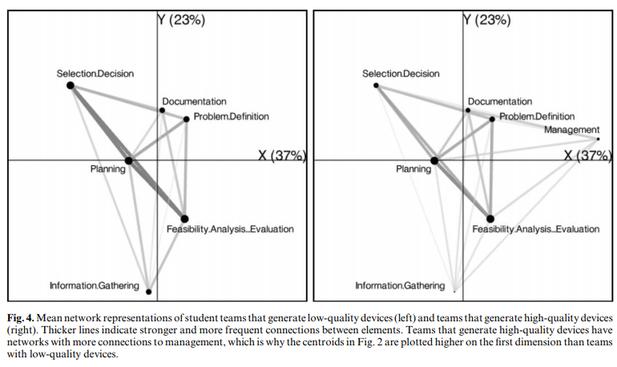
Studying Process of Successful and Unsuccessful Teams (Arastoopour et al., 2016)

Slide 31
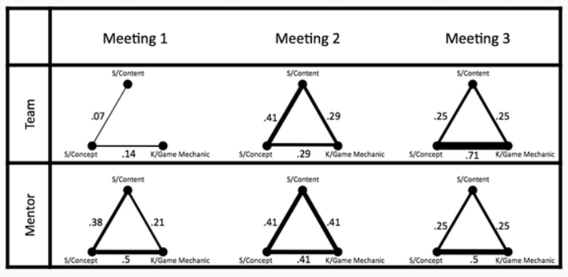
Studying connections between topics in meetings over time (Nash & Shaffer, 2013)

Slide 32
Questions? Comments?

Slide 33
Has anyone here…
… conducted an ENA?
If so, please tell us about it

Slide 34

To learn more about ENA
EDUC5100 Quantitative Ethnography

Slide 35

To learn more about SNA
EDUC7847 Social and Statistical Network Analysis

Slide 36
Other questions or comments?

Slide 37
The End

